Slide 1
CMPE 351 LAB3
PRACTICE ON W3SCHOOLS DATABASE
PART II

Slide 2
More on SQL
Go to https://www.w3schools.com/sql/sql_top.asp
Complete the tutorials from “SQL Top” to “SQL Comments”.
Run the examples on your own and solve the exercises on the website.
Go to SQL Tryit editor page of w3schools:
https://www.w3schools.com/sql/trysql.asp?filename=trysql_select_all
It is also possible to reach this editor from any example on the tutorial pages.
You can see the content of sample database by clicking the tablenames listed on the right side of the window.
Solve the questions on the next slides, save your answers to a txt file and submit.

Slide 3
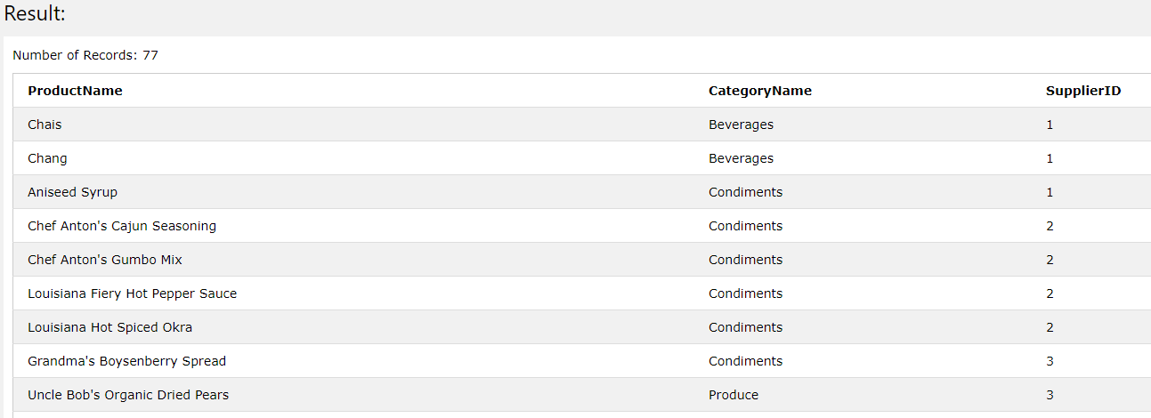
Exercises
Query all product names and their supplier id’s with their category names (ordered by supplier id). The result should look like this:

Slide 4
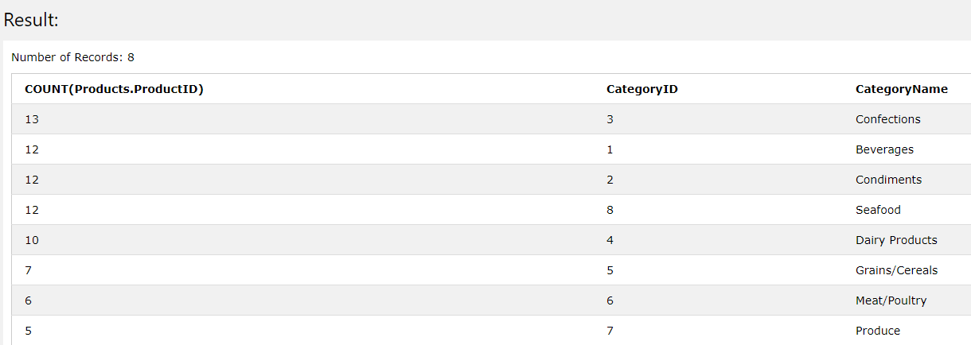
List the number of products in each category in descending order along with the category names, the result should look like this:

Slide 5
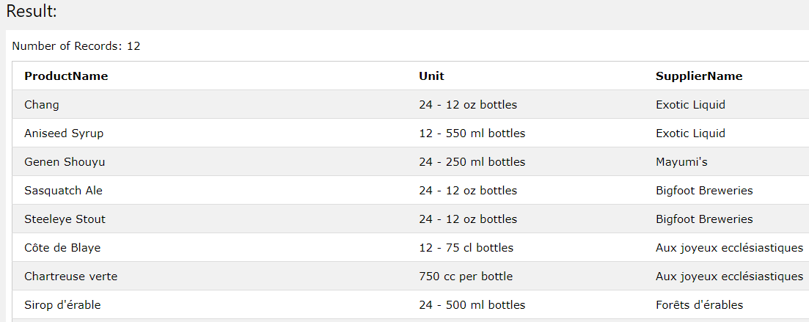
Query the product names, units and supplier names of the products contained in bottle(s).(Hint: use wildcards on Unit column)

Slide 6
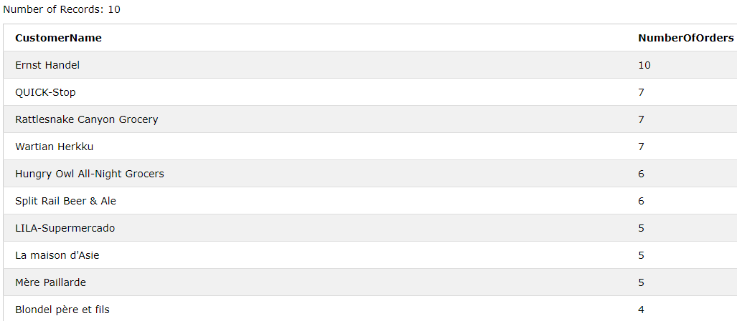
Query the names and the number of orders(as NumberOfOrders) of the top 10 customers that have more than 3 orders (in descending order).

